Slide 1
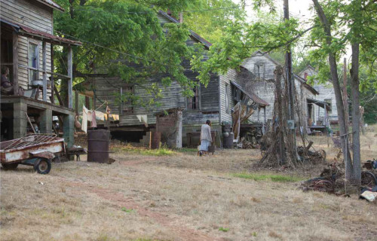
What would it be like to live here?
Notes:
What sort of people would live there?

Slide 2
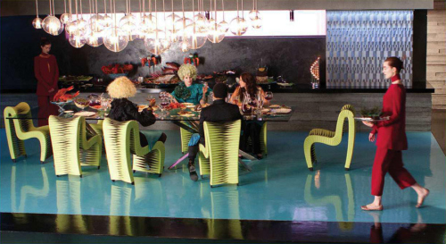
What would it be like to live here?

Slide 3
Learning objective
To explore one of the key themes of the novel.
To analyse the writer’s choice of words and language.

Slide 4
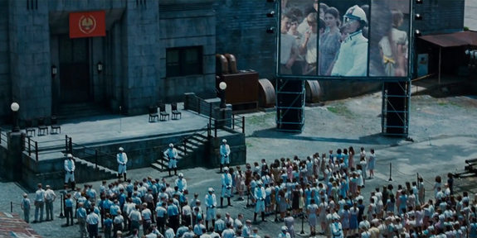
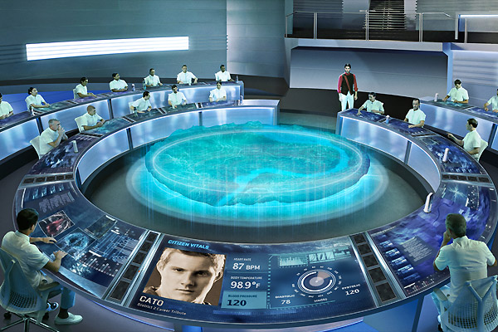
Inequality: The Capitol vs. The Districts
So far, what differences have we come across between District 12 and The Capitol?
 | District 12 | The Capitol
The people
The buildings
The clothes
The food
The atmosphere
The leisure time
Anything else?
Task: Draw two columns in your book. Label one ‘District 12’ and one ‘The Capitol’. As we are reading this chapter, record the differences between the two places.

Slide 6
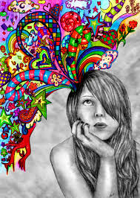
Learning objective: To analyse the writer’s choice of words and language.
Read this description of The Capitol. Fill in the gaps with the best adjectives and verbs you can think of.
The cameras hadn’t lied about its ________. If anything, they have not quite captured the ________ of the ________ buildings in a rainbow of hues that _______ into the air, the _______cars that _______ down the ______, ______ streets, the ______ dressed people with _______ hair and _______ faces who have __________.
Challenge: Which do you think is the best word you have selected? Why did you choose that word? What effect were you trying to create?

Slide 7
Learning objective: To analyse the writer’s choice of words and language.
Read the description of District 12. Fill in the gaps with the best adjectives and verbs you can think of.
“Men and women with ______ shoulders, _____ knuckles, many of whom have long since stopped trying to ______ the coal dust out of their ______ nails and the _______ of their ______ faces.”
Challenge: Which do you think is the best word you have selected? Why did you choose that word? What effect were you trying to create?

Slide 8

Learning objective: To analyse the writer’s choice of words and language.
“Men and women with hunched shoulders, swollen knuckles, many of whom have long since stopped trying to scrub the coal dust out of their broken nails and the lines of their sunken faces.” (pg 4-5)
“I’d grown up seeing those home kids at school. The sadness, the marks of angry hands on their faces, the hopelessness that curled their shoulders forwards.” (pg 31)
“The cameras hadn’t lied about its grandeur. If anything, they have not quite captured the magnificence of the glistening buildings in a rainbow of hues that tower into the air, the shiny cars that roll down the wide paved streets, the oddly dressed people with bizarre hair and painted faces who have never missed a meal. All the colours seemed artificial, the pinks too deep, the greens too bright, the yellow painful to the eyes.” (Page 68)
Notes:
As each word is revealed and discussed (with pupils suggestions/examples given as well) get the pupils to annotate their sheets in their books with analysis for the language used. Frame discussion around: “Why did the author choose to use the word she did and not the word you have suggested”

Slide 9
Although the whole idea of our children being taken from us as tributes to a wealthy elite seems rightly horrific, consider that District 12 (where Katniss, our protagonist, is from) is set in the coal mining region of our current Appalachia, not far from here. And the difference in opportunities for a child growing up in Manhattan among the wealthy elites and a child growing up in Appalachia, the Louisiana Delta, or other impoverished regions of our country, while not as epically heinous as the Hunger Games do call us to question the inequalities that we permit to exist in our own society.
And while The Hunger Games can be viewed as simply young adult entertainment, the author Suzanne Collins is well aware of the parallels she is drawing to our current society.

Slide 10
Inspiration
What inspired Collins to write ‘The Hunger Games’?
She was inspired whilst flicking through channels between a “mindless reality TV show game and coverage of the start of the Iraq War.”

Slide 11
Written response
Form a written response to this question:
In what ways are the inequalities presented to us in ‘The Hunger Games’ similar to the inequalities in modern society?

Slide 12
The inequalities between the districts and The Capitol and the way in which the government only works for the wealthy are very much like the inequalities raised by the Occupy Wall Street movement. Their main focus is that the government works primarily for the wealthy, or the 1%, leaving the rest of the country, or the 99%, behind. As Huffington Post writer Bob Burnett comments, “Collins doesn’t use the terms 1 percent and 99 percent, but it’s clear that those in the Capitol are members of the 1 percent and everyone in the Panem districts is part of the 99 percent” (Burnett). In this way, “The Hunger Games” is engaging with the ideas of socio-economic inequality, which is relevant for the US audience, especially since the nation of Panem is quite recognizable as North America. For example, the forests Katniss hunts in and her district’s history of coal mining are reminiscent of the Appalachian Mountains and surrounding area. This recognizable setting primes the audience to the issue by bringing to mind the inequalities seen in the US today.
http://loveandguns.wordpress.com/2012/11/23/inequality-in-the-hunger-games/

